Slide 1

Azure OpenAI Service

Slide 2
Agenda
Azure OpenAI Service Overview
Introduction to AOAI Models
GPT – 3
Codex
DALL-E
Why OAI vs AOAI
Uses and Capabilities
Pricing Details
Customer Examples

Slide 3
Generative AI
Artificial Intelligence
1956
Artificial Intelligence
the field of computer science that seeks to create intelligent machines that can replicate or exceed human intelligence
Machine Learning
1997
Machine Learning
subset of AI that enables machines to learn from existing data and improve upon that data to make decisions or predictions
Deep Learning
2017
Deep Learning
a machine learning technique in which layers of neural networks are used to process data and make decisions
2021
Generative AI
Create new written, visual, and auditory content given prompts or existing data.
Notes:
Narrative/talk track:
What is a brief history of artificial intelligence?
Artificial intelligence (AI) has a long and storied history that spans many decades. Some of the earliest work in AI was done in the 1950s and 1960s, when researchers first began to explore the possibility of creating machines that could "think" like humans.
During the 1950s and 1960s, AI research focused primarily on "symbolic" AI, which involved creating symbolic representations of knowledge and using them to solve problems. Researchers in this field developed early versions of what are now known as expert systems, which are computer programs that mimic the decision-making abilities of human experts in a specific domain.
In the 1970s and 1980s, AI research began to shift away from symbolic AI and towards "sub-symbolic" AI, which involves using statistical methods and mathematical models to solve problems. This shift was driven in part by the realization that symbolic AI was too complex and difficult to scale, and in part by the development of new computer hardware that made it possible to process large amounts of data quickly.
In the 1990s and 2000s, AI research continued to evolve, and new subfields began to emerge. One of these was "machine learning," which focuses on creating algorithms that allow computers to learn from data without being explicitly programmed. Another was "neural networks," which are mathematical models inspired by the structure and function of the human brain.
Recently, Generative Models like GPT-3 and DALL-E, Variational Autoencoders, Generative Adversarial Networks and many more have risen and continue to advance the field of AI. These models are able to generate new examples that are similar to examples from a given dataset. It is being used in diverse fields such as natural language processing, computer vision, speech recognition and many more.
Overall, AI has come a long way since its inception in the 1950s, and it continues to evolve and improve at a rapid pace today.
What is Generative AI and where does it fit into the scope of AI?
Generative AI is a subfield of Artificial Intelligence that focuses on creating systems that can generate new examples, such as images, text, or speech, that are similar to examples from a given dataset. The goal of generative AI is to develop algorithms that can learn the underlying probability distribution of a given dataset and use this knowledge to generate new examples that are similar to the examples in the dataset.
Generative AI models can be classified into two broad categories: generative models and discriminative models. Generative models such as GPT-3, DALL-E, Variational Autoencoders etc learns the underlying probability distribution of the dataset and can generate new examples from the learned distribution. Discriminative models, such as deep neural networks, learn to differentiate between different classes or categories, and are generally used for tasks such as image or speech recognition.
Generative AI sits on top of other areas of AI like unsupervised learning, supervised learning and reinforcement learning. It relies on the capability of those models to extract useful features from the data and use that for learning the underlying probability distribution of the data which is used for generthe potential to be used in a wide range of applications, such as computer vision, natural language processing, speech recognition, and many more.
ating new examples.
Overall, generative AI is a rapidly growing field within AI, and it has

Slide 4
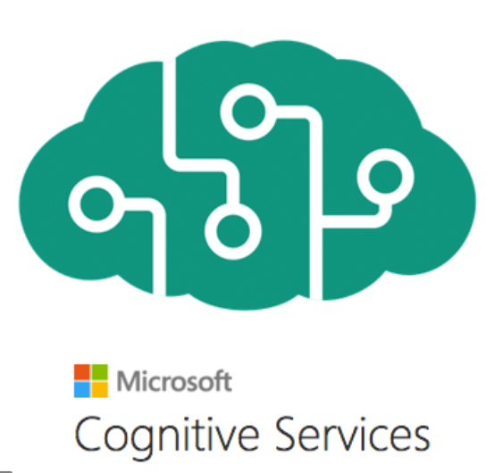











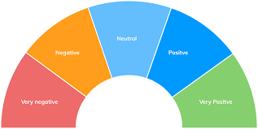

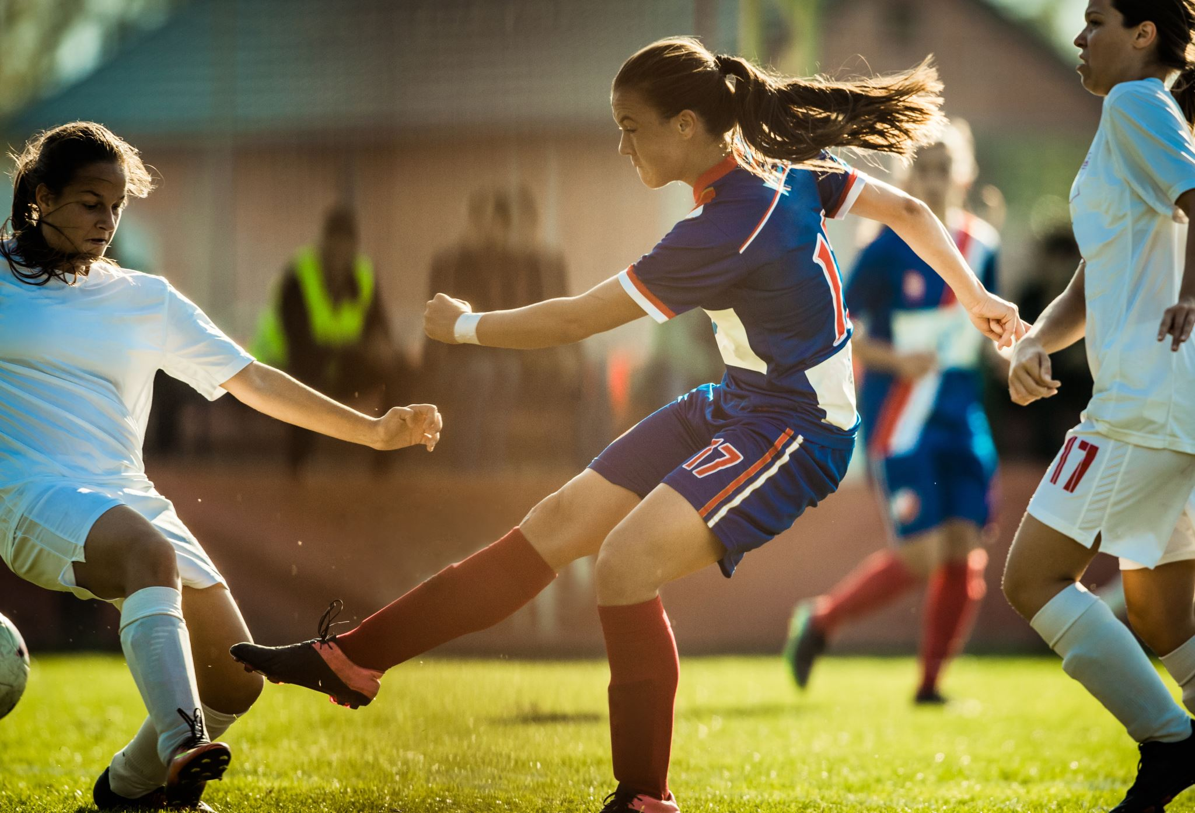
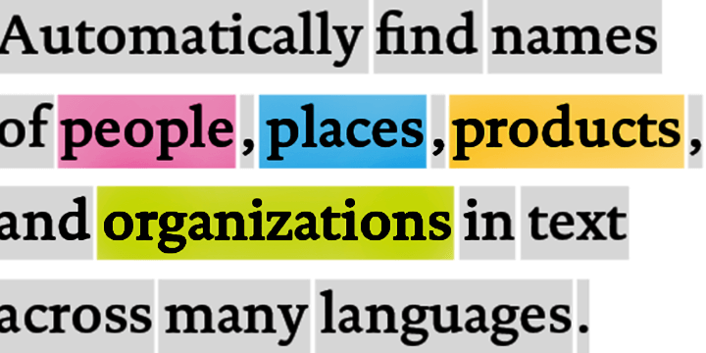
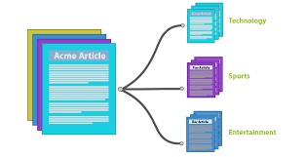








Traditional model development High cost and slow deployment—each service is trained disjointly
DEPLOYMENTS
Tagging Services
Spatial Analysis Services
Accessibility Services
Spatial Presenter
Azure Search, Video Indexer
EAGLE
EAGLE
FLOWER
PLAYING SOCCER
Classification
Object Detection
Object Tracking
Action Recognition
Entities
Topics
Sentiments
TASKS
Classification Model
Detection Model
Tracking Model
Action Model
Entity Recognition
Topic Classification
Sentiment Analysis
INDIVIDUAL MODEL (DISJOINTLY)
TRAINING DATA
(w/ ANNOTATION)
Tagging data
Detection data
Tracking data
Action data
Entity data
Topic data
Sentiment data
Notes:
(This and the next 9 slides help with the flow to move from the high-level to the deep dive)
The traditional approach of AI model development involves training a model on a very specific dataset with a specific task in-mind. For example, an entity recognition model requires specifically tagged entity data and a sentiment analysis model requires specifically trained sentiment data, which can be a bottleneck in training ML models. As a result, not only is a lot of tagged data required, but the data remains segmented for specific tasks, leading to higher development costs and slower deployments.

Slide 5

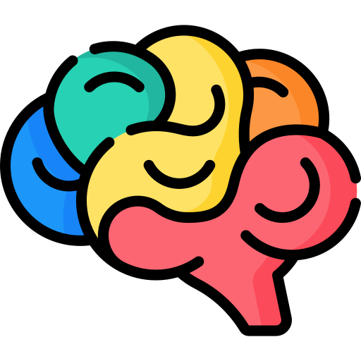







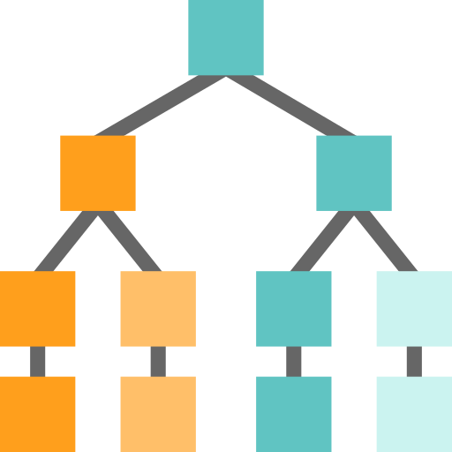




Foundation Models
Tasks
Question and Answering
Data
Sentiment Analysis
Text
Foundation Model
Information Extraction
Images
Speech
Training
Adaptation
Image Captioning
Structured Data
3d Signals
Transformer Model
Object Recognition
Instruction Follow
Notes:
The future of AI is models that are flexible, reusable and that can be applied to just about any domain or industry task.
Foundation models are at the heart of many of the latest breakthroughs. These models have been influential in the development of artificial intelligence systems, and have played a major role in changing how AI systems are constructed since their introduction in 2018.
A foundation model is a machine learning model that is trained on a large amount of unlabeled data, allowing it to be adapted to a wide variety of tasks. These models capture general patterns and structure of data, and aim to replace task-specific models by unifying different tasks and modalities into one, eliminating the need to train individual models and integrate several models together. An example is a large language foundation model that can perform various NLP tasks and can be used out-of-the-box due to its extensive training.
Foundation models use self-supervised learning and transfer learning to apply information learned in one situation to another situation or task.
Training these models can be complex and resource-intensive as they are typically large and require a significant amount of data. The scale of these models also plays a big role in the training process. So lets talk about that.

Slide 6



Why is the sky blue?
OpenAI GPT-3 answer:
The sky is blue because the Earth's atmosphere scatters sunlight in all directions and blue light is scattered more then the other colors because it travels as shorter, smaller waves
Notes:
I’m sure many of you have heard of Open AI’s GPT-3 , this model has literally mastered language and can talk about anything.

Slide 7


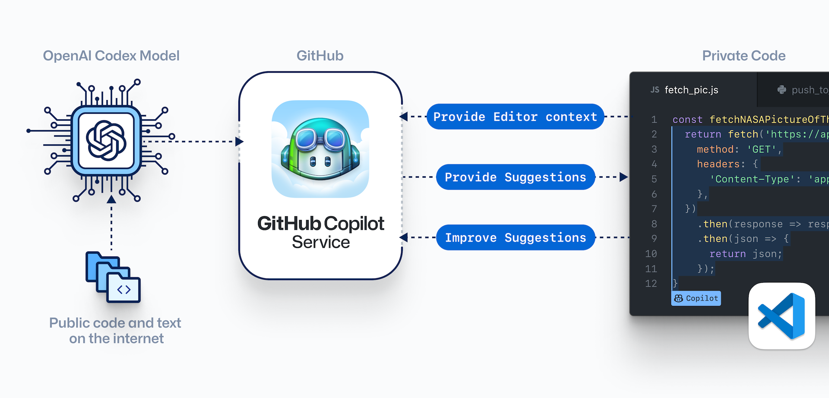

OpenAI + Github
OpenAI Codex Model
GitHub
Private code
Provide editor context
Provide suggestions
Improve suggestions
GitHub Copilot Service
Public code and text on the internet
Notes:
GitHub Copilot, is an AI pair programmer that you can collaborate with and helps to write code and helps you learn new frameworks and best practices.
According to CEO from Github, Copilot is now handling up to 40% of coding among programmers. Put another way, for every 100 lines of code, 40 are being written by the AI,
with a total project time cut by up to 55%. And this is just with the first iteration of the model which has been in production for less than one year.

Slide 8

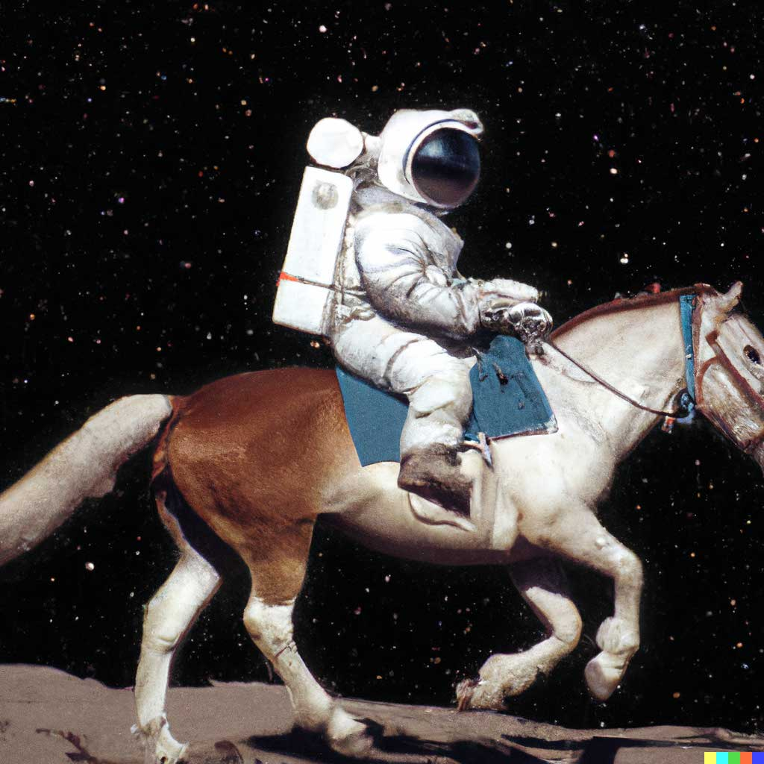


DALL E 2
An astronaut riding a horse in a photorealistic style
Teddy bear working on new AI research on the moon in 1980
A bowl of soup that looks like a monster knitted out of wool
Notes:
OpenAI Dalle-2 model can seemingly create spectacular images from just text

Slide 9




NUWA | Infinity
Text to image
Image to video
A cloudy morning on the beach with the tide coming in
Mountains with clouds
Notes:
And even more recently, this a new multimodal generative model called NUWA Infiniti announced at our Microsofts Research, this model can also generate high-quality images just from text and can even predict the next frame to generate life like videos.

Slide 10


Our partnership with OpenAI
Ensure that artificial general intelligence (AGI) benefits humanity.
Empower every person and organization on the planet to achieve more
GPT-3
Codex
DALL·E
ChatGPT (coming soon)
Generate and Understand Text
Generate and Understand Code
Generate images from text prompts
Generate conversational responses
Notes:
Narrative/talk track:
The MSFT / OpenAI partnership and how we collaborate
Microsoft has formed a partnership with OpenAI to collaborate on the development of artificial intelligence technologies. The partnership aims to accelerate the development of advanced AI systems and bring the benefits of AI to more people.
As part of the partnership, Microsoft and OpenAI have agreed to work together on several key areas, including:
Developing AI technologies: The two companies will collaborate on the development of new AI models and algorithms, with a focus on natural language processing, computer vision, and other areas of AI.
Building an AI computing platform: Microsoft and OpenAI will work together to build a new AI computing platform that will allow developers to easily access and use advanced AI models and algorithms.
Advancing AI research: The two companies will also collaborate on a range of research projects aimed at advancing the state of the art in AI.
Making AI more accessible: The partnership aims to make AI more accessible to a wider range of developers and organizations, in order to bring the benefits of AI to more people.
Microsoft has also announced it will use OpenAI's GPT-3 technology to add more capabilities to its products such as Cortana, Power Virtual Agents and Dynamics 365.
Additionally Microsoft has also made an investment in OpenAI, allowing the company to use Microsoft Azure as its preferred cloud platform, and allowing OpenAI to tap into the vast resources of Microsoft to accelerate its research. This partnership gives OpenAI the ability to scale its models and services on Azure and make them more widely available to customers.
Overall, the partnership between Microsoft and OpenAI aims to accelerate the development and use of advanced AI technologies, with a focus on making AI more accessible to developers and organizations, in order to bring the benefits of AI to more people.

Slide 11


Generative AI
GPT-3
Codex
DALL·E
ChatGPT
Prompt:
Write a tagline for an ice cream shop.
Response:
We serve up smiles with every scoop!
Prompt:
Table customers, columns = [CustomerId, FirstName, LastName, Company, Address, City, State, Country, PostalCode]
Create a SQL query for all customers in Texas named Jane
query =
Response:
SELECT *
FROM customers
WHERE State = 'TX' AND FirstName = 'Jane'
Prompt: A white Siamese cat
Response:
What is the fastest animal on land?
the cheetah (Acinonyx jubatus), which can reach speeds of up to 60 miles (97 kilometers) per hour.
What makes them so fast?
Cheetahs are built for speed and have several adaptations that make them the fastest land animal: lean body, long legs, flexible spine, large nostrils and claws that don’t retract.
Notes:
GPT-3 is for text completion. A set of models that can understand and generate natural language.
Codex is a set of models that can understand and generate code, including translating natural language to code. It is a descendant of GPT-3 that’s been trained on both natural language and code.
DALL•E is a set of models that can generate or manipulate images from natural language.

Slide 12

Azure OpenAI Service
Deployed in your Azure subscription, secured by you, and tied to your datasets and applications
Large, pretrained AI models to unlock new scenarios
Custom AI models fine-tuned with your data and hyperparameters
GPT-3
Codex
Built-in responsible AI to detect and mitigate harmful use
DALL·E
ChatGPT
Enterprise-grade security with role-based access control (RBAC) and private networks

Slide 13
Azure OpenAI | Family of Models
GPT-3 models
Codex models
Davinci
Davinci-codex
Curie
Cushman-codex
Inferencing time
Babbage
Ada
Capability
Capability

Slide 14
Azure OpenAI | GPT-3 Family of Models
Model
Max # Tokens per Request
Description, performance, cost
Use cases
Davinci
Curie
Babbage
Ada
4,096 tokens
2048 tokens
2048 tokens
2048 tokens
Most capable GPT-3 model. Can do any task the other models can do, often with higher quality, longer output and better instruction-following.
Very capable, but faster and lower cost than Davinci.
Capable of straightforward tasks, very fast, and lower cost.
Capable of very simple tasks, usually the fastest model in the GPT-3 series, and lowest cost.
Complex intent, cause and effect, summarization for audience
Language translation, complex classification, text sentiment, summarization
Moderate classification, semantic search classification
Parsing text, simple classification, address correction, keywords
Notes:
While Davinci is generally the most capable, the other models can perform certain tasks extremely well with significant speed or cost advantages. For example, Curie can perform many of the same tasks as Davinci, but faster and for 1/10th the cost.
We recommend using Davinci while experimenting since it will yield the best results. Once you’ve got things working, we encourage trying the other models to see if you can get the same results with lower latency. You may also be able to improve the other models’ performance by fine-tuning them on a specific task.

Slide 15
Azure OpenAI | Comparing the GPT-3.5 models
Model
Description
text-davinci-002
text-davinci-003
ChatGPT model (gpt-3.5)
A GPT-3.5 model that was fine-tuned on natural language instructions and can perform a variety of tasks including summarization, question answering, classification, and more.
An improvement over the text-davinci-002 model. The model is similar to its predecessor but generally more capable across all tasks.
A model fine-tuned from text-davinci-002 that was optimized for working with dialogue. ChatGPT is a great model to use for conversational tasks and also excels at creative tasks.
Visit the Azure OpenAI Service pricing page for pricing details

Slide 16

Azure OpenAI | Overview of GPT-3
Generative pre-trained transformer 3 (GPT-3)
Autoregressive language model that uses deep learning to produce human-like text
Pre-trained on trillions of words
Predicts the most likely next word based on input text
General text-in/text-out interface

Slide 17
Azure OpenAI | GPT-3 Models
General purpose text-in/text-out interface—flexibility
Powerful language models accessible to all skill levels
Simple UX—validate proof of concepts fast
Built in ML science intuition for everyone, with deeper controls for ML practitioners

Slide 18
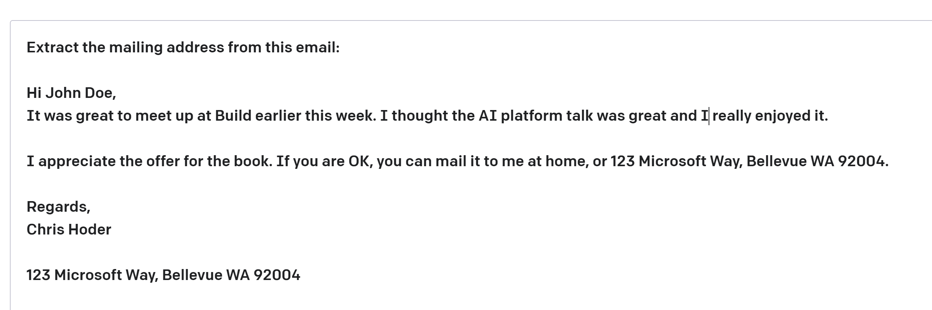
Azure OpenAI | GPT-3 Prompt Design
some context
Completion—Output that GPT-3 generates based on the prompt.
Prompt—Text input that provides some context to the engine on what is expecting.
Notes:
Prompt design (or prompt engineering)
There are three basic guidelines to creating prompts:
Show and tell. Make it clear what you want either through instructions, examples, or a combination of the two. If you want the model to rank a list of items in alphabetical order or to classify a paragraph by sentiment, show it that's what you want.
Provide quality data. If you're trying to build a classifier or get the model to follow a pattern, make sure that there are enough examples. Be sure to proofread your examples — the model is usually smart enough to see through basic spelling mistakes and give you a response, but it also might assume this is intentional and it can affect the response.
Check your settings. The temperature and top_p settings control how deterministic the model is in generating a response. If you're asking it for a response where there's only one right answer, then you'd want to set these lower. If you're looking for more diverse responses, then you might want to set them higher. The number one mistake people use with these settings is assuming that they're "cleverness" or "creativity" controls.

Slide 19
Azure OpenAI | GPT-3 Ideate, Experiment and Fine-Tune
Iterate on ideas with a general-purpose text-in/text-out interface
Refine with examples (‘few shot learning’) with
a simple UX
Optimize accuracy and latency to validate proof of concept fast
Prompt
Prompt
Prompt and completion examples
Summarize game commentary into highlights:
Shey Peddy is applying ball pressure at the top against Sabrina Ionescu. At 7:48 remaining in the quarter; Peddy
What are the main highlights of the game so far?
Turn game commentary into highlights:
Commentary: What a pickup she has
Main highlights: New York has domina
###
Commentary:
1. Turner is so important defensively to
2. Griner pulled way out, Hartley with
3. At 1:54 remaining in the quarter, Pho
Examples
"hyperparams": {
"batch_size": 4,
"learning_rate_multiplier": 0.1,
"n_epochs": 4,
"prompt_loss_weight": 0.1,
"use_packing": true
}
Fine-tuning
Inputs
Azure OpenAI Service
Sample response
Sample response
The game has been close with Phoenix leading New York 7-5. Shey Peddy has been key for Phoenix.
Main highlights: 1. New York has had a strong run in the 2. Phoenix leading by 1 point, 24-23 3. New York Liberty's comeback has be
Results

Slide 20
Codex Models
Makes APIs more accessible
Accelerates software development
Widens who can code

Slide 21
Codex Models
Derived from base models and trained on both NL and code (billions of Lines of Code)
Support multiple programming languages
Python, C#, SQL, Java, JavaScript, TypeScript, Go, Perl, PHP, Ruby, Swift, Shell (bash)
Multiple tasks:
Comment → Code
Autocomplete function or next line (in context)
Knowledge searching (API or Library call)
Documenting code (comments)
Refactoring
Use Cases
Natural Language to Code
Documenting code (comments)
Refactoring
Code to Natural Language
Natural Language to SQL

Slide 22
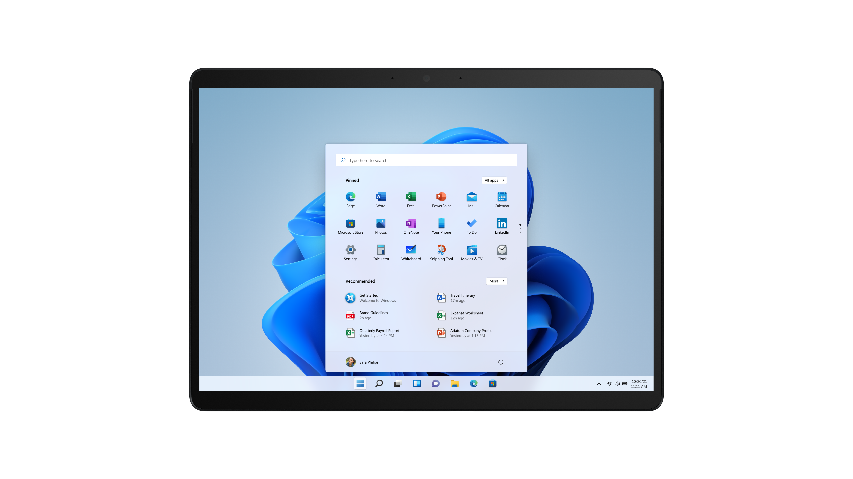
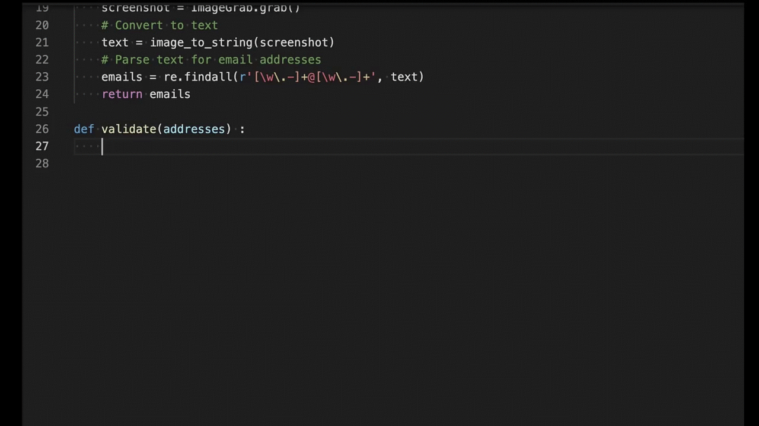
Codex Models

Slide 23
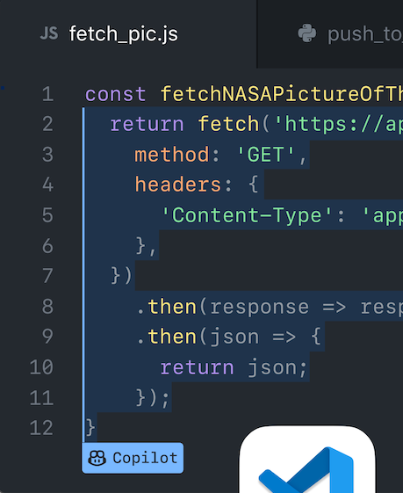



OpenAI Codex Model
OpenAI Codex Model
GitHub
Private code
Provide editor context
Provide suggestions
Improve suggestions
GitHub Copilot Service
Public code and text on the internet

Slide 24
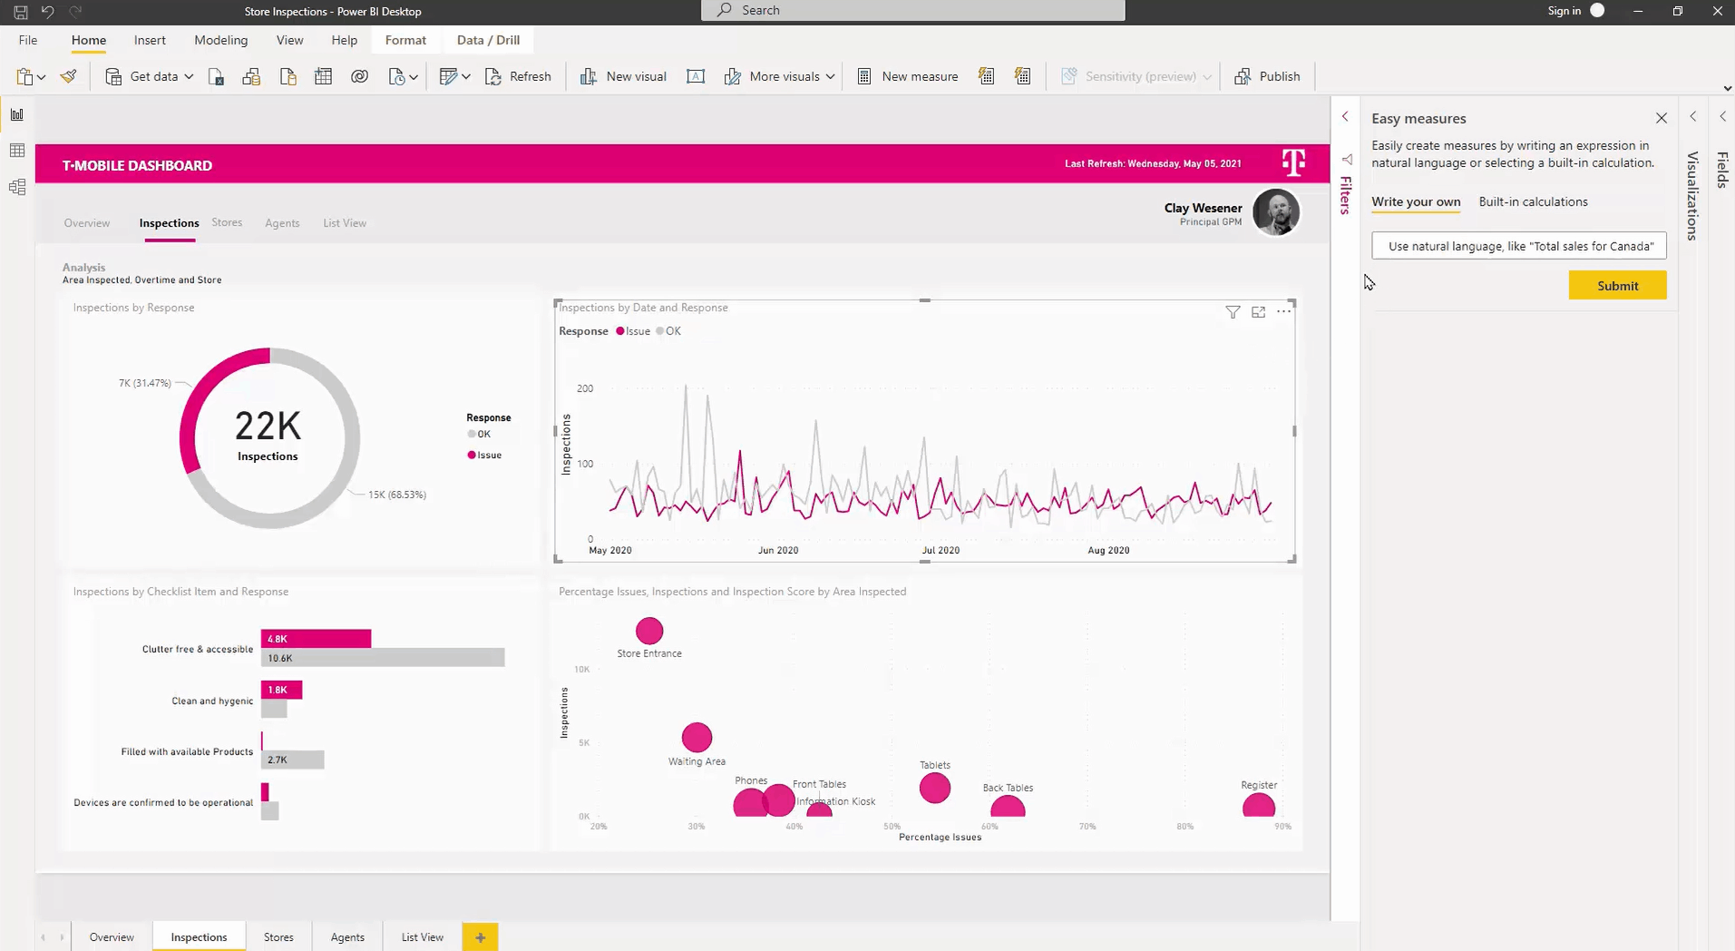
Power BI Generating DAX expressions with natural language
Notes:
Customers can use natural language to describe what they’re trying to accomplish and have Power BI automatically create a DAX expression for them, powered by GPT-3. By using natural language to create DAX calculations, we are further democratizing the ability to create sophisticated business logic without having to become a DAX expert.
More information: Enabling intelligent experiences with Power BI for developers, data scientists, and data engineers | Microsoft Power BI Blog | Microsoft Power BI

Slide 25
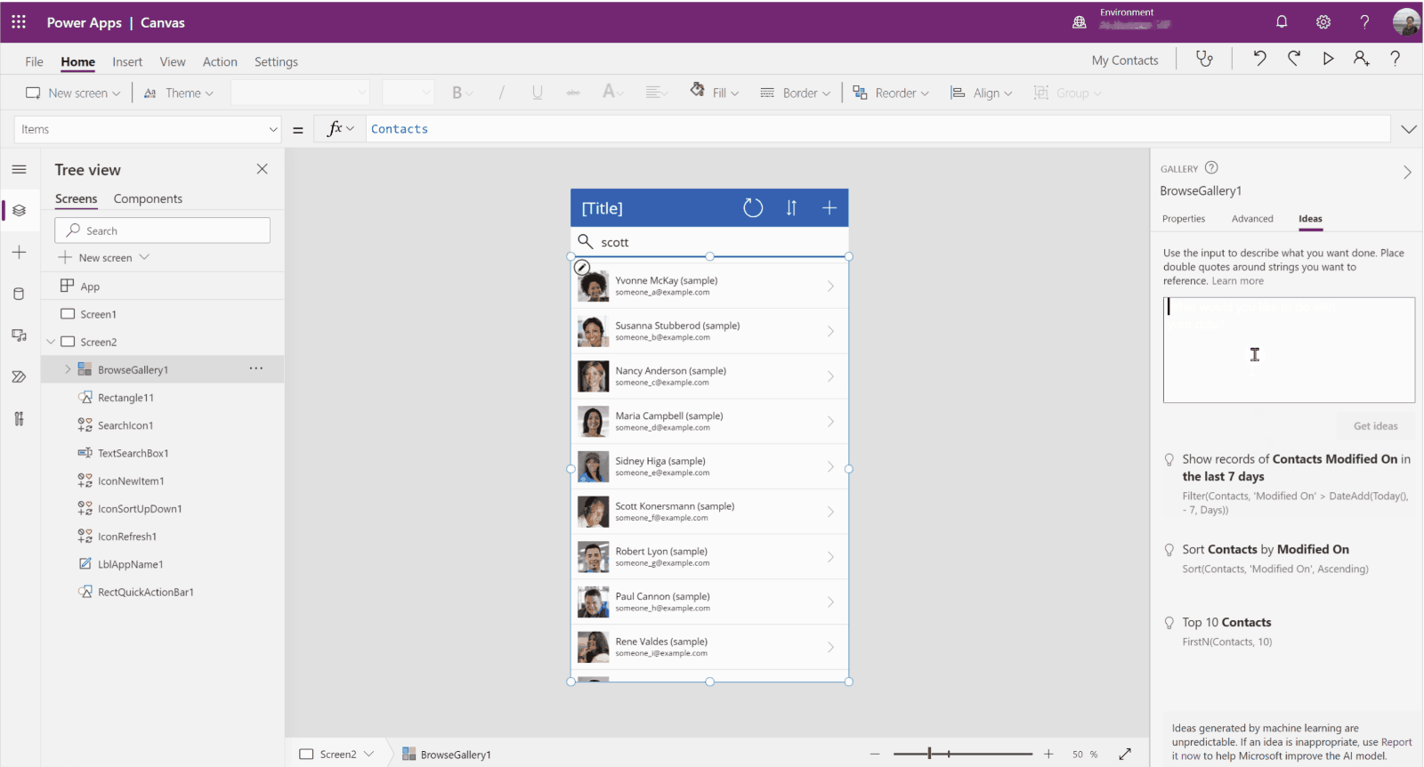
Power Platform Power Fx formulas
Notes:
Customers can generate Power Fx formulas with the help of the GPT-3 model and use them to build your app in Power Platform.
More information: Getting Started with GPT-3 in Power Platform - Developer Support (microsoft.com)

Slide 26
DALL•E 2
Generate an infinite number of images with simple text prompts
Accelerate designs or inspire creative decision
Build capability into enterprise applications through APIs and SDKs

Slide 27
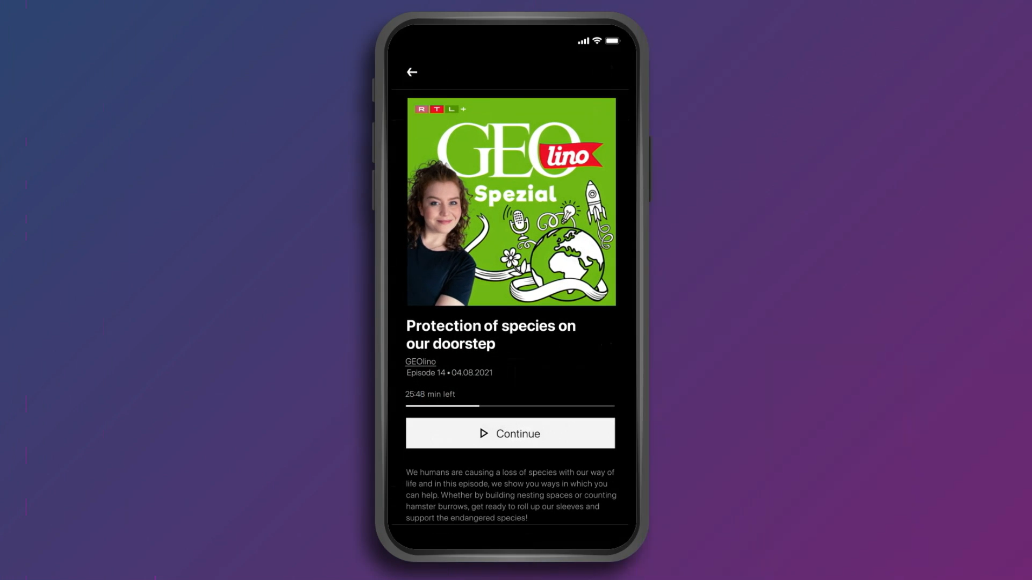
RTL
Notes:
RTL, the largest media company in Germany, will create personalized imagery for audiobook and podcast listeners as part of their subscription service

Slide 28
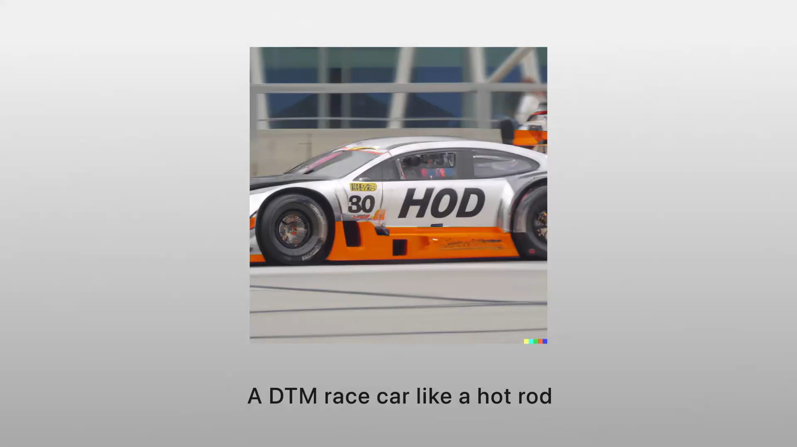
Mattel
Notes:
Mattel has been using DALLE to spark creativity across the entire organization from toy design to marketing

Slide 29
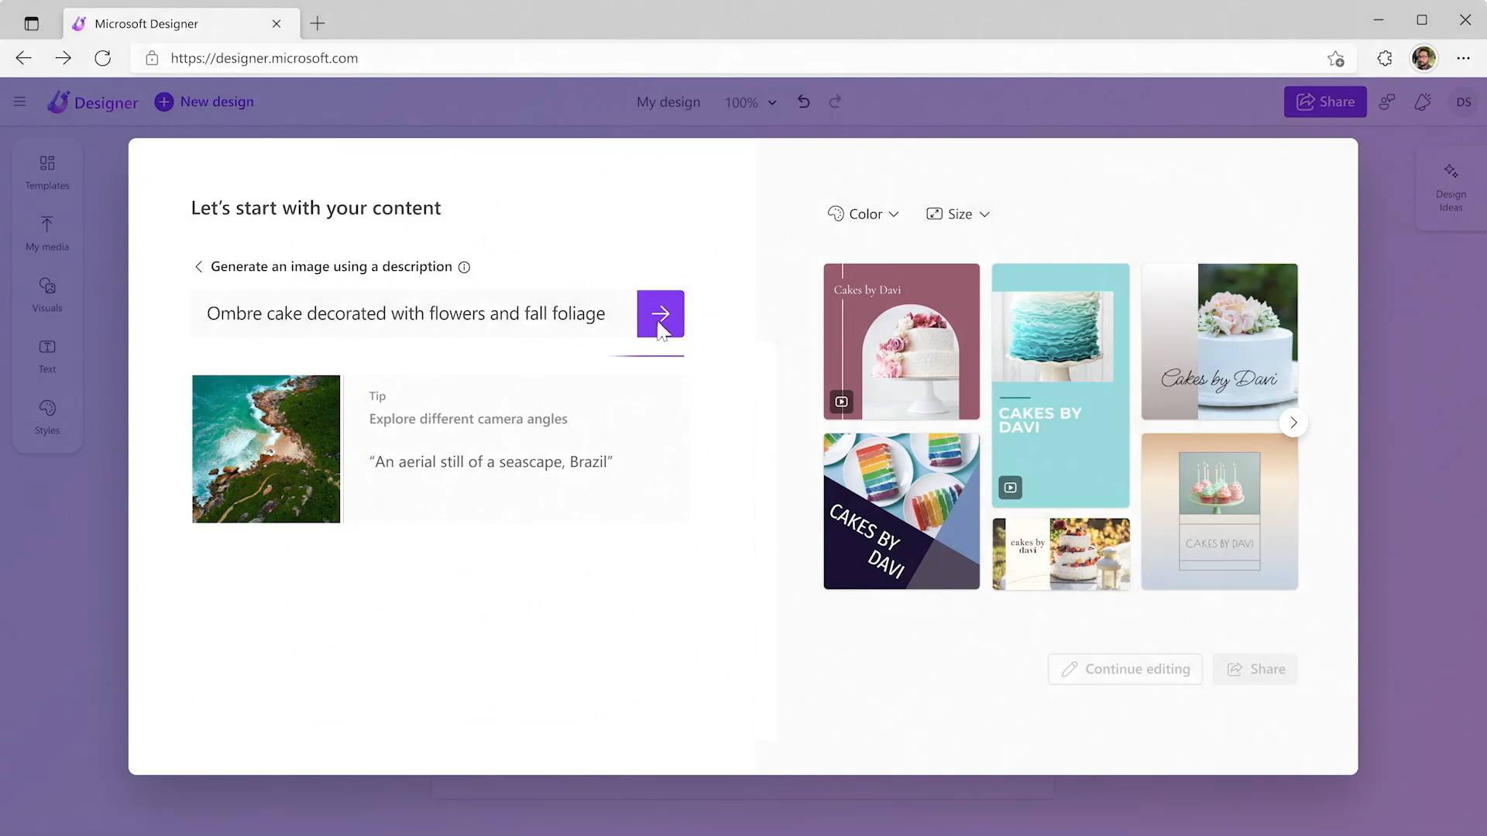
Microsoft Designer

Slide 30






Azure OpenAI | When to use it
I need a general-purpose model that can handle multiple tasks.
e.g., translation+entity recognition+sentiment analysis
I need to generate human-like content, whilst preserving data privacy and security
e.g., abstractive summarization, content writing, paraphrasing, code
I need rapid prototyping and quick time to market for many use cases
I could use a model with little or no additional training
I want to explore solutions / use cases that have been described previously
Azure OpenAI Service
Vision
Speech
Language
Decision
Azure Cognitive Services
Notes:
Other more advanced use cases where OpenAI could be a good fit:
Customizing / fine-tuning an embeddings model for search scenarios or domain specific semantic matching
Synthetic Data generation for training ML models
Scenario’s where model adaptive learning is required, reinforcement learning (*InstructGPT-text-davinci-003)

Slide 31


OpenAI, Azure OpenAI Service, Cognitive Service to Language
OpenAI
Azure OpenAI Service
Cognitive Service for Language
Developer experience & applicability
A broad set of text/code/image generative use-cases:
Flexible generative text, code and image API
Popular examples scenarios—Copywriting, summarization, chatbots, code generation, image generation in design tools
Experimentation with newest alpha models
Everything stated for OpenAI, plus:
Production-ready workloads requiring capacity
Apps with global user-base requiring geo-diversity
Apps requiring built-in content filtering and RAI checks
Apps with compliance, data privacy and security needs
Widely known language use-cases:
Extraction, classification, chatbots, and summarization with formal support for multiple languages
Translate text, and docs of any format—often used for web page localization
Projects requiring quick turn-around; minimal tuning
Pricing
Priced per 1K tokens. Training and inference
Optimized for prototyping
Priced per 1K tokens. Training, inference & hosting
Fine-tuned models optimized for production
Service priced per 1K text records. Predictable.
Very competitively priced
Production- and enterprise-readiness
Limited enterprise-grade capabilities
GA—2023
Azure Active Dir, Data residency & compliance, data security, Azure SLA guarantee, global availability zones, Responsible AI
Currently GA
Azure Active Dir, Data residency & compliance, data security, Azure SLA guarantee, global availability zones, Responsible AI
Notes:
NOTE FOR MICROSOFT PRESENTER: If asked, please acknowledge that OpenAI can develop and sell commercial solutions on its own (i.e. without Microsoft, except insofar would still be hosted in Azure). More information about our partnership is available in the Field FAQs: aka.ms/AOAI-FieldFAQ

Slide 32
Azure OpenAI | Benefits
Increased efficiency and productivity by getting more done in lesser time through rapid prototyping and quicker time to market*
Faster time to realize value
Enhanced customer experience with a greater focus on customer-centric services and products, whilst utilizing feedback and trends better
Easy to use: Even junior data scientists or business users can use Azure OpenAI Service Playground
Ensure data privacy & security, and implement it in a responsible manner using a Trusted Cloud Provider
Does not require a long tedious annotation process*
Less training data is required for many relevant use cases*
Ability to perform text analytics and generation tasks that up until now were reserved only to humans
* in most relevant use cases observed
Notes:
- Increased Efficiency: OpenAI’s AI-powered technology increases operational efficiency and reduces the amount of time and resources needed to complete complex tasks.
- Improved Decision Making: OpenAI’s technology provides real-time insights and data-driven decisions, reducing the risk of making wrong choices.
- Enhanced Customer Experience: OpenAI’s AI-driven technology makes it easier to provide customers with tailored experiences, resulting in increased customer satisfaction.
- Cost Savings: OpenAI’s AI-based technology reduces expenses related to developing, deploying, and managing software applications.
- Increased Productivity: OpenAI’s AI-driven technology enables businesses to get more done in less time, resulting in increased productivity.
1. Education: One of the most promising applications for GPT-3 is in education. The ability to generate realistic, natural language explanations of concepts could be a powerful tool for students of all levels.
2. Healthcare: GPT-3 could also be used to generate personalized health advice and information. The ability to generate realistic, natural language explanations of medical concepts could be a valuable resource for patients and doctors alike.
3. Business: GPT-3 could be used to generate reports, proposals, and other business-related documents. The ability to generate realistic, natural language explanations of business concepts could be a valuable asset for any organization.
4. Journalism: GPT-3 could be used to generate news articles and other journalistic content. The ability to generate realistic, natural language explanations of current events could be a valuable resource for any news organization.
5. Entertainment: GPT-3 could also be used to generate realistic, natural language descriptions of movies, TV shows, and other forms of entertainment. The ability to generate realistic, natural language explanations of entertainment concepts could be a valuable asset for any media company.

Slide 33
Unlock new use cases
Content generation | Call Center Analytics: Automatically generate responses to customer inquiries Government agency using Azure OpenAI Service to extract and summarize key information from their extensive library of rural development reports Financial services using Azure OpenAI Service to summarize financial reporting for peer risk analysis and customer conversation summarization
Code generation | Aircraft company using to convert natural language to SQL for aircraft telemetry data Consulting service using Azure OpenAI Service to convert natural language to query propriety data models
Semantic search | Financial services firm using Azure OpenAI Service to improve search capabilities and the conversational quality of a customer’s Bot experience. Insurance companies extract information from volumes of unstructured data to automate claim handling processes
Summarization | International insurance company using Azure OpenAI Service to provide summaries of call center customer support conversation logs Global bank using Azure OpenAI Service to summarize financial reporting and analyst articles
Notes:
Narrative/talk track:
But based on our work with customers on Azure OpenAI, we find 4 capabilities that seem to stand out: Content generation, Summarization, Code Generation and Semantic Search.
Content generation has sparked a lot of interest among those who want to be able to automate responses to customers, or generate personalized UI for their company’s website or with recruitment firms who want to be able to generate content for bringing in their ideals applicants.
The second popular capability of Azure OpenAI has been summarization. There’s so much goodness here for call center analytics scenarios where companies would want to summarize conversation logs, or to be able to summarise long and tedious reports or tonnes of analyst articles. Social media trend summarization is another use that is important for companies to know what their customers are heading towards and what their industry is trending towards.
Code generation – the third popular capability…. Think of wanting to convert your SQL to NL or vice versa. Code generation is powerful capability that can help to convert code, as well as generate text and source code directly into your application.
Last but not the least, Semantic Search with Azure OpenAI will help quicken the time to search through documents.
These use cases are particular to these 4 categories or capabilities of Azure OpenAI that we are discussing here. IN addition to these, we also have some examples of multiple model use cases that are very popular among our customers:
End to end call center analytics that takes your process all the way from classification through to email generation to increase productivity and save time and effort during call center operations.
Customer 360 where hyper-personalization will use more than one of the above capabilities to ensure you have a complete and holistic view of your customers and are increasing your customer satisfaction, whilst using feedback and trends to serve them better in the future.
Business Process Automation like document automation where we use capabilities across search, code generation and content generation to do things faster and more efficiently.

Slide 34
Examples of multiple model use cases
End-to-end call center analytics
Customer 360
Business process automation
Classification
Sentiment
Entity extraction summarization
Email generation
Hyper-personalisation using timely Summarization of customer queries & trends
Search
Content generation
Search through structured & unstructured documentation
Generate Code to query data models
Content Generation
Notes:
Narrative/talk track:
But based on our work with customers on OpenAI, we find 4 capabilities that seem to stand out: Content generation, Summarization, Code Generation and Semantic Search.
Content generation has sparked a lot of interest among those who want to be able to automate responses to customers, or generate personalized UI for their company’s website or with recruitment firms who want to be able to generate content for bringing in their ideals applicants.
The second popular capability of OpenAI has been summarization. There’s so much goodness here for call center analytics scenarios where companies would want to summarize conversation logs, or to be able to summarise long and tedious reports or tonnes of analyst articles. Social media trend summarization is another use that is important for companies to know what their customers are heading towards and what their industry is trending towards.
Code generation – the third popular capability…. Think of wanting to convert your SQL to NL or vice versa. Code generation is powerful capability that can help to convert code, as well as generate text and source code directly into your application.
Last but not the least, Semantic Search with OpenAI will help quicken the time to search through documents.
These use cases are particular to these 4 categories or capabilities of OpenAI that we are discussing here. IN addition to these, we also have some examples of multiple model use cases that are very popular among our customers:
End to end call center analytics that takes your process all the way from classification through to email generation to increase productivity and save time and effort during call center operations.
Customer 360 where hyper-personalization will use more than one of the above capabilities to ensure you have a complete and holistic view of your customers and are increasing your customer satisfaction, whilst using feedback and trends to serve them better in the future.
Business Process Automation like document automation where we use capabilities across search, code generation and content generation to do things faster and more efficiently.

Slide 35

Azure OpenAI Service Use cases
Codex
Natural Language to Code
Natural Language to SQL
Code to Natural Language
Code documentation
Refactoring
DALL·E 2
Creative ideation
Podcast and music playlist images
Content syndication
Marketing campaign personalization
Hyper-personalization

Slide 36
Azure OpenAI Service Use cases
Language
Reason over structured and unstructured data: Classification, Sentiment, Entity Extraction, Search
Refined text-based search with embeddings
Product feedback sentiment
Customer and employee feedback classification
Claims and risk analyses
Support emails and call transcripts
Social media trends
Writing assistance
Marketing copy/email taglines
Long format text
Paragraphs from bullets

Slide 37
Azure OpenAI Service Use cases
Language
Summarization
Call center call transcripts
Subject Matter Expert Documents
Competitive analysis
Peer Analysis
Technical reports
Product and service feedback
Social media trends
Conversational AI
Smart assists for call centers
Tech support chat bots
Virtual assistants
Artificial humans

Slide 38
Azure OpenAI Service Use cases
Language
Use Cases that use multiple model capabilities
Contact Centers
Classification—route mails to appropriate team
Sentiment—prioritize angry customers
Entity extraction and search—analyze liability and risk
Mail and call transcript summarization
Customer response email generation
Rapid response marketing campaigns: classification, sentiment, summarization, content generation, image generation

Slide 39
Additional considerations
This is only a REST API. It needs to be connected to applications and/or business processes to be useful.
These models use input from instructions and examples in the prompt to identify the task.
The model completes the task by predicting the most probable next text.
In the next section(s), we will cover three main approaches for in-context learning.
There are some additional considerations when choosing a use case. Learn more

Slide 40
Pricing details
Please visit the Azure OpenAI Service Pricing Details page for the most up-to-date pricing information

Slide 41


STRABAG
The margins in construction are narrow, so it’s important for companies to pick the right projects to work on.
Strabag SE used Azure OpenAI Service to build an AI-based risk management solution that assesses which construction projects might fail – therefore minimizing the risks that come with it and saving time and money.
“With just three months of data, this algorithm can predict risk with 80% accuracy – it’s mind-blowing!”
- Dr. Marco Bornschlegl, Head of Innovation and Digitalisation
Strabag SE
Notes:
https://customers.microsoft.com/en-us/story/1596825960615628483-strabag-discrete-manufacturing-azure-en-austria

Slide 42

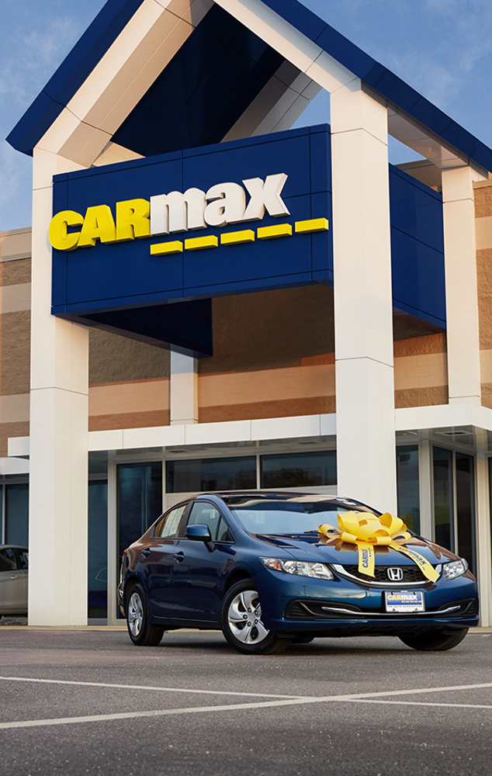
CARMAX
Since 1993, CarMax has grown from an industry-disrupting startup to become the United States’ leading used car retailer.
CarMax uses Azure OpenAI Service to streamline the creation of text summaries for its car research pages, quickly providing customers with meaningful content that also boosts the pages’ search engine rankings.
“With the help of OpenAI Service, we’re disrupting our industry for a second time by delivering cutting-edge digital tools and capabilities and becoming a true omnichannel retailer.”
Shamim Mohammad, Executive Vice President and Chief Information and Technology Officer
CarMax
Notes:
https://customers.microsoft.com/en-us/story/1501304071775762777-carmax-retailer-azure-openai-service

Slide 43


TRELENT
Trelent uses cutting-edge AI algorithms to provide intelligent source code documentation for its clients.
To scale its solution and accommodate the data security and residency needs of enterprise customers around the globe, Trelent chose to migrate its solution to Microsoft Azure OpenAI Service.
“With a product like OpenAI Service behind you, you can focus a lot more on what really matters, which is delivering a great experience, a great product, and a lot of value to your customers.”
Calum Bird, CEO
Trelent
Notes:
https://customers.microsoft.com/en-us/story/1549838968222249829-trelent-azure-openai-service

Slide 44
FAQ

